Slide 1
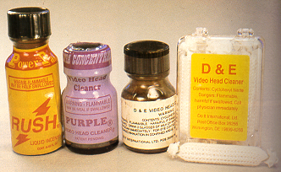
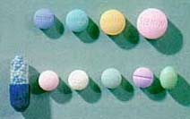
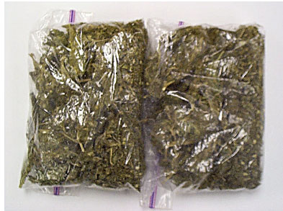




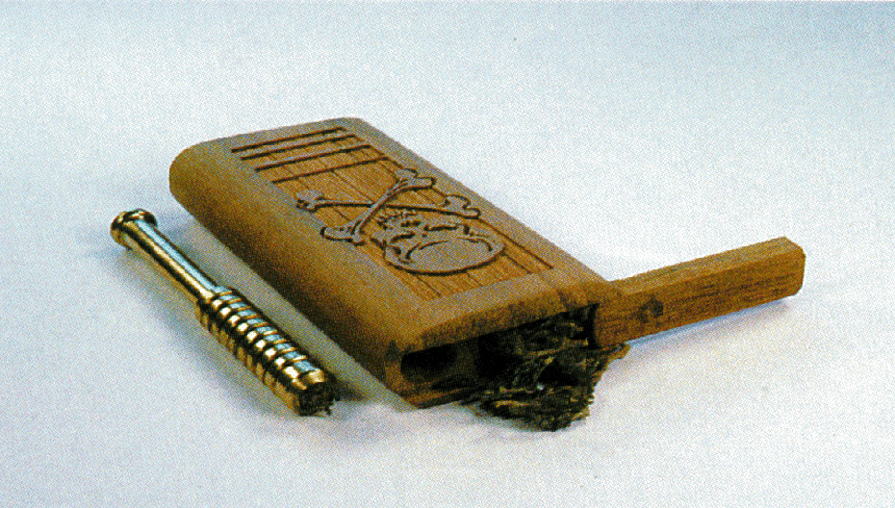
Session 6
Seven Drug Categories

Slide 2
Learning Objectives
  Identify common drug names and terms associated with the seven drug categories
  Identify common methods of administration for each category
  Describe indicators of impairment associated with each category

Slide 3
Learning Objectives
  Describe conditions which may mimic signs and symptoms associated with each drug category
  List indicators which may emerge during the three phases of the DWI detection process which may indicate the subject is under the influence of a drug(s)

Slide 4
Seven Categories of Drugs
CNS Depressants
CNS Stimulants
Hallucinogens
Dissociative Anesthetics
Narcotic Analgesics
Inhalants
Cannabis

Slide 5

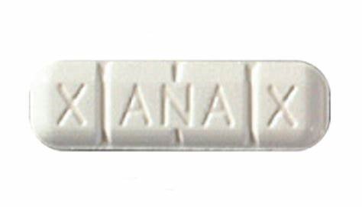
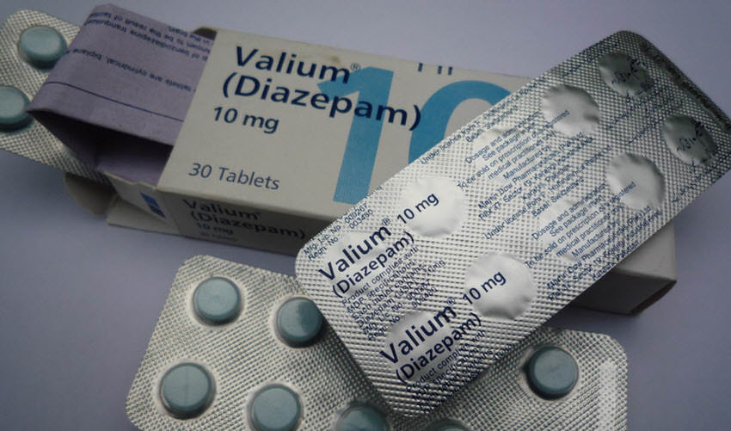
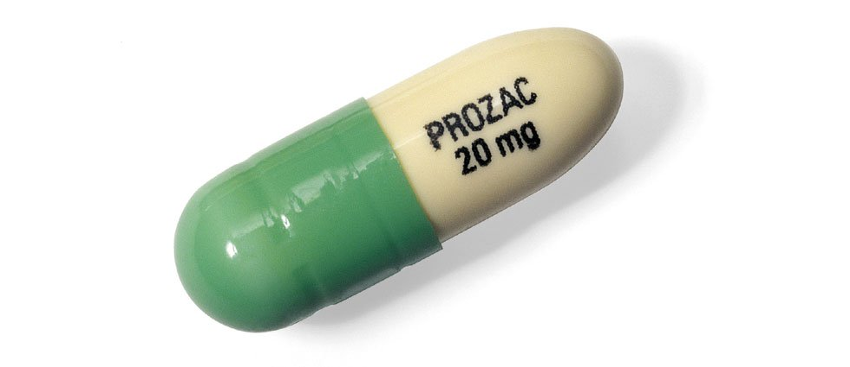
Seven Drug Categories
CNS Depressants

Slide 6
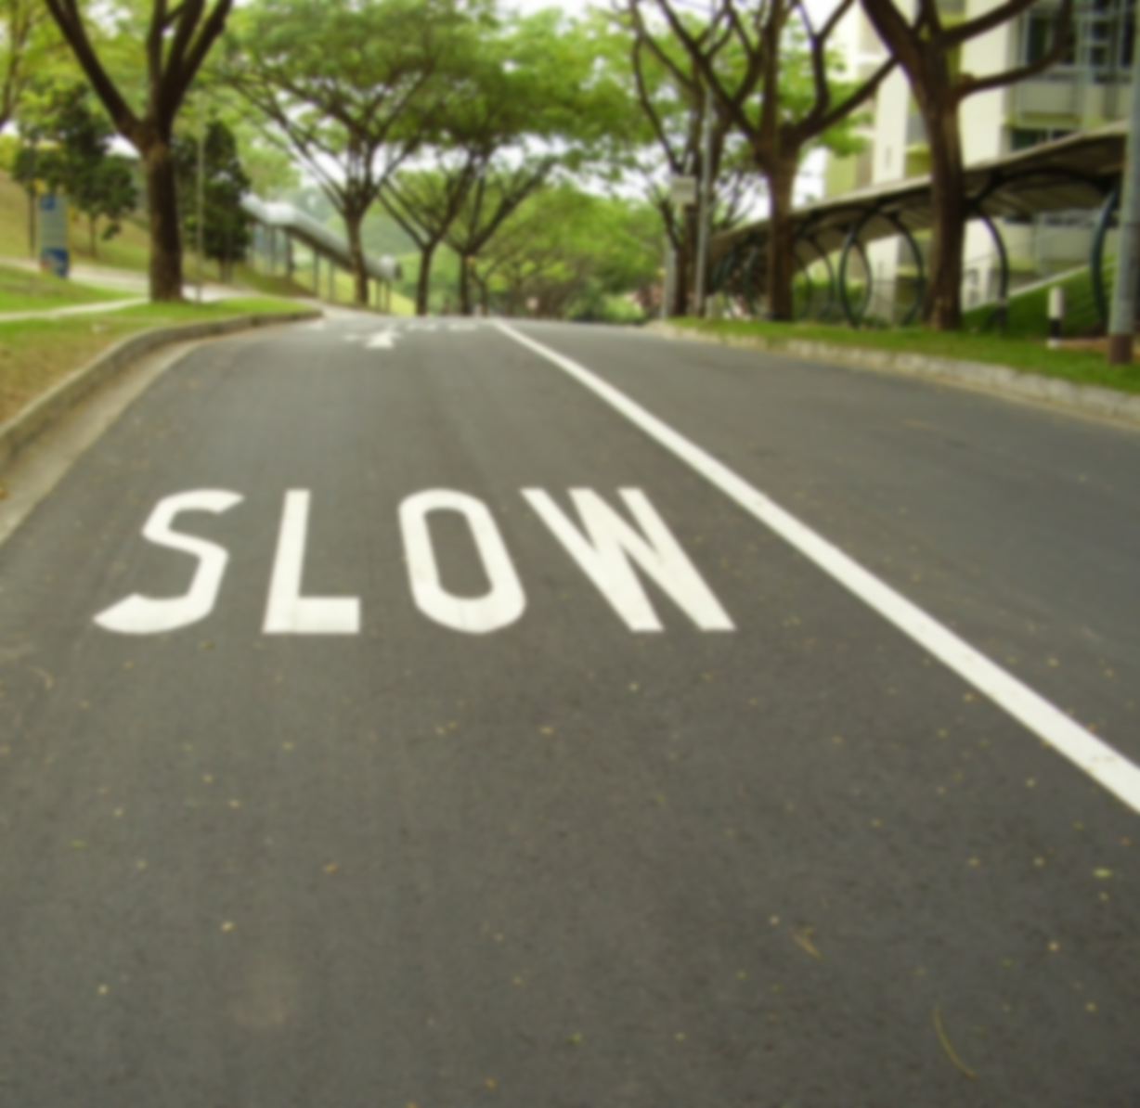
CNS Depressant
Depressants slow down the activity of an individual’s brain and central nervous system.

Slide 7
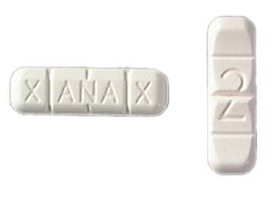
Commonly Abused
CNS Depressants
    Alcohol
    Ambien
    Klonopin
    Soma
    Valium
    Xanax

Slide 8
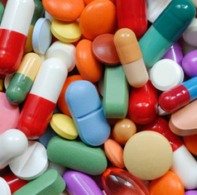
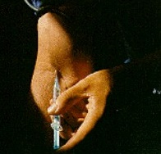
Methods of Administration
  Oral
  Insufflation
  Injection

Slide 9
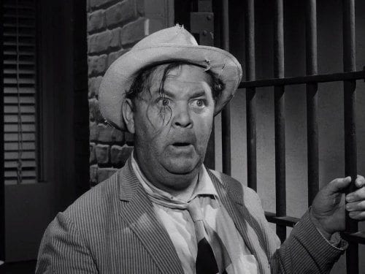
Effects of CNS Depressants
Wide variety of emotional effects
Divided attention impairment
Disoriented
Sluggish
Thick, slurred speech
Drunk-like behavior

Slide 10

General Indicators
Droopy eyelids
Drowsiness
Relaxed inhibitions
Uncoordinated
Unsteady walk

Slide 11
Eye Indicators
HGN | Present
VGN | May be Present (high dose)
LOC | Present
Pupil Size | Normal*
*Soma, Quaaludes, and some Antidepressants usually dilate pupils

Slide 12
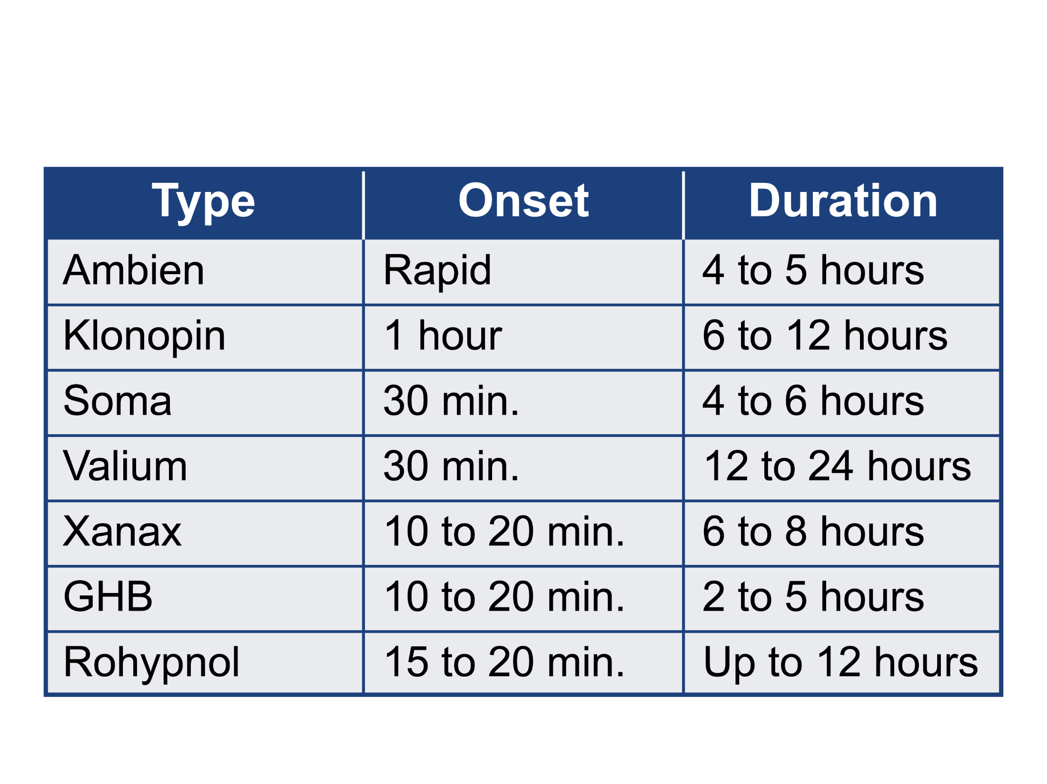
Onset and Duration of Effects

Slide 13
Overdose Signs and Symptoms
    Clammy skin
    Coma
    Rapid/weak pulse
    Shallow breathing

Slide 14
Conditions That May Mimic
Drug Impairment
    Diabetic reactions
    Extreme fatigue
    Head injuries
    Hypotension
    (low blood pressure)
    Inner ear disorders
    Severe depression

Slide 15
Drug Matrix
 | CNS Dep. | CNS Stim. | Hall. | D.A. | N.A. | Inhalant | Cannabis
HGN | Present
VGN | Present
LOC | Present
Pupil Size | Normal *
* Soma, Quaaludes, and some Antidepressants usually dilate pupils

Slide 16
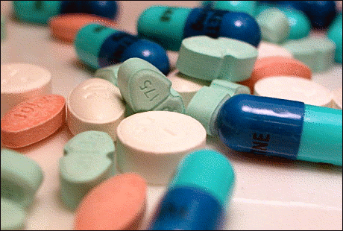
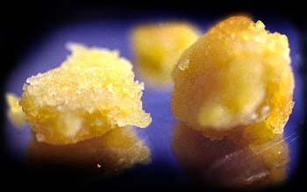
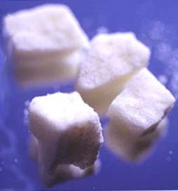
Seven Drug Categories
CNS Stimulants

Slide 17
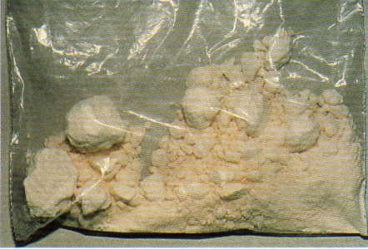
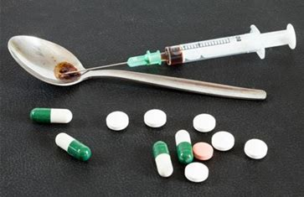
Widely Abused CNS Stimulants
  Cocaine
  Amphetamines
  Methamphetamines

Slide 18

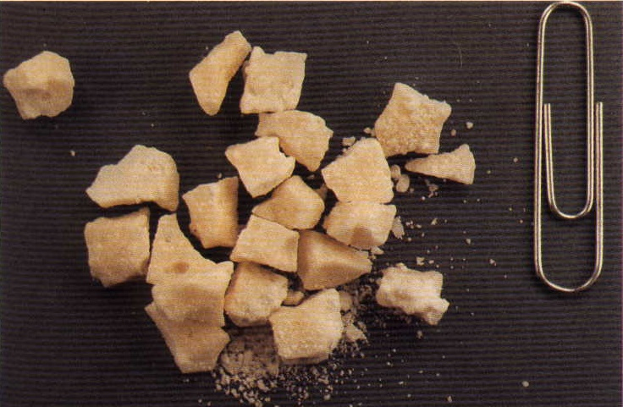
Cocaine

Slide 19
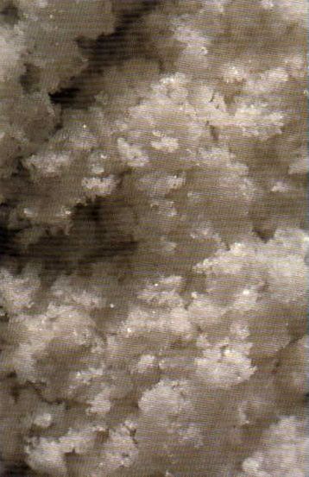
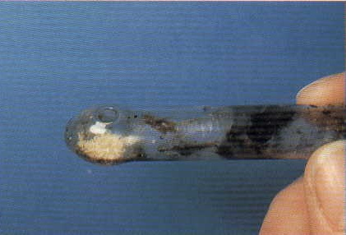
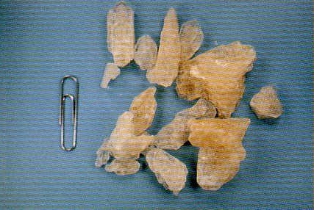
Amphetamines

Slide 20
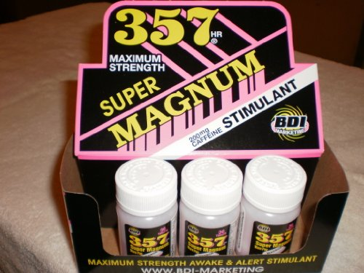
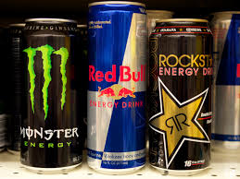
Other CNS Stimulants
  Energy drinks
  OTC

Slide 21
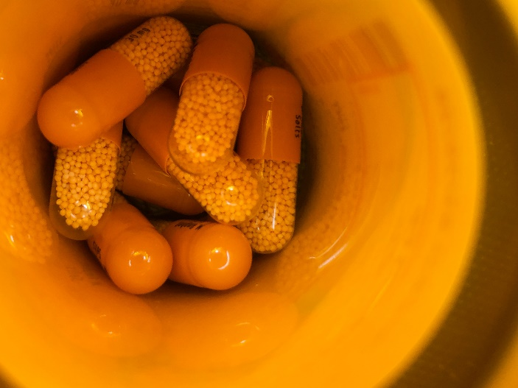
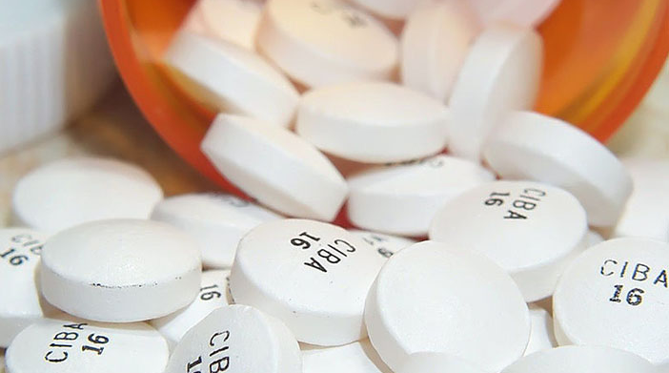
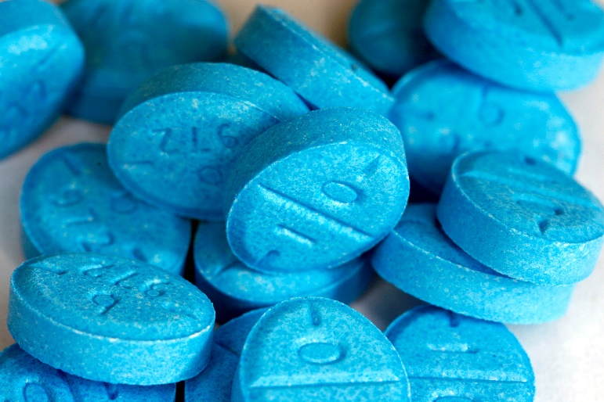
Prescribed
CNS Stimulants
  Ritalin
  Adderall
  Dexedrine

Slide 22
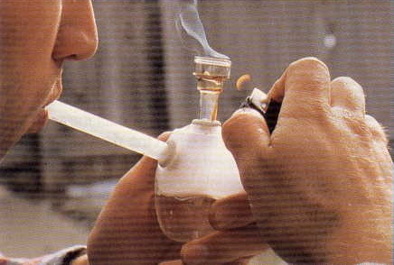
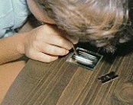
Methods of Administration
  Insufflated
  Injected
  Smoked
  Oral

Slide 23
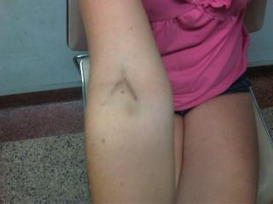
Signs of Administration
  Powder residue in nasal cavity
  Blisters on lips and tongue
  Injection marks

Slide 24

Effects of CNS Stimulants
  Euphoria – an extremely pleasurable sensation (while drug is psychoactive)
  Opposite effect as drug wears off

Slide 25
General Indicators of Impairment
Eyelid and body tremors
Grinding teeth (bruxism)
Restlessness
Talkative

Slide 26
Eye Indicators
HGN | None
VGN | None
LOC | None
Pupil Size | Dilated

Slide 27
Duration of Effects
Type | Duration
Cocaine | Up to 2 hours
Amphetamines, Methamphetamines | 4 – 8 hours
Ritalin, Adderall, Dexedrine | Varies

Slide 28
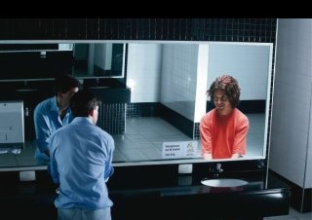
Overdose Signs and Symptoms
  Hallucinations
  Psychosis
  Violent behavior

Slide 29
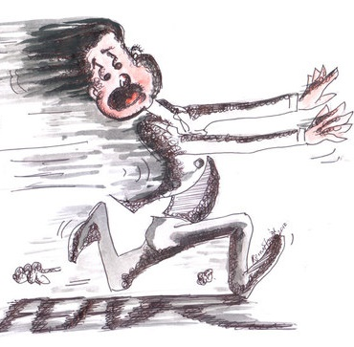
Conditions That May Mimic
Drug Impairment
Hyperactivity
Nervousness
Stress
Fear

Slide 30
Drug Matrix
 | CNS Dep. | CNS Stim. | Hall. | D.A. | N.A. | Inhalant | Cannabis
HGN | Present | None
VGN | Present | None
LOC | Present | None
Pupil Size | Normal * | Dilated
* Soma, Quaaludes, and some Antidepressants usually dilate pupils

Slide 31
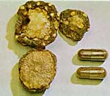
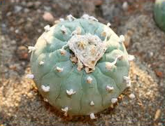
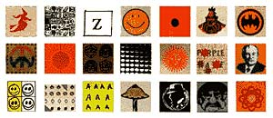
Seven Drug Categories
Hallucinogens

Slide 32

Hallucinogens
Hallucinogens affect a person’s:
  Perception
  Sensation
  Thinking
  Self-awareness
  Emotional state

Slide 33

Hallucinogens
An example of a hallucination would be seeing sounds and hearing colors
This is called Synesthesia – the transposition of senses

Slide 34
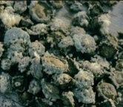
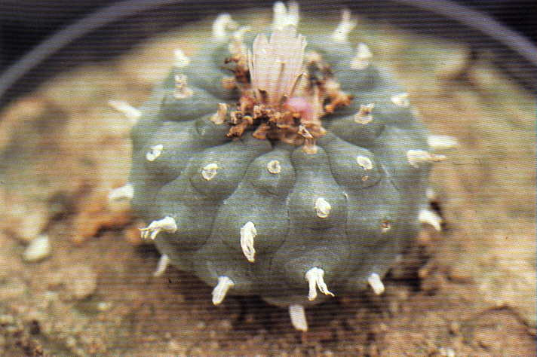
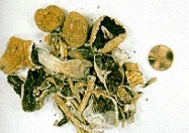

Natural Hallucinogens
Peyote (Mescaline)
Psilocybin
(Both are grown naturally)

Slide 35
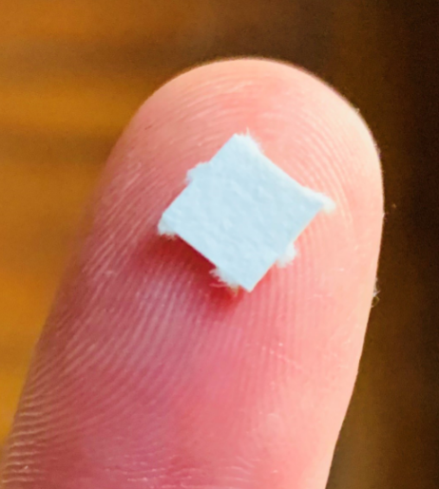
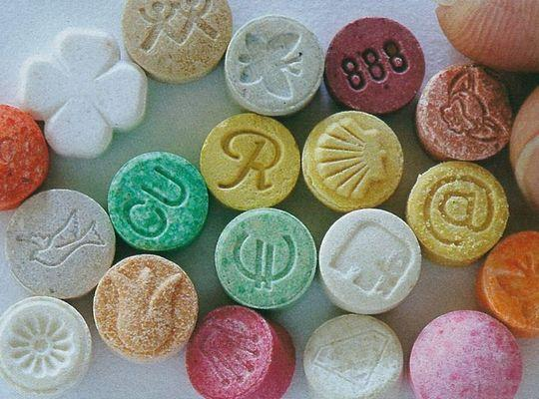
Synthetic Hallucinogens

Slide 36

Methods of Administration
  Oral
  Transdermal
  Smoked
  Injected
  Insufflation

Slide 37
Effects of Hallucinogens
  Generally intensifies mood of user at time of administration
  If user is depressed – you could observe a deeper depression
  If user is feeling pleasant – you could see a heightened pleasure

Slide 38

Effects of Hallucinogens
  Can uncover emotional flaws in user
  User may expect a pleasurable “trip,” but end up instead with a bad “trip”

Slide 39
General Indicators
Body tremors
Dazed appearance
Hallucinations
Impaired perception of time and distance
Nausea
Paranoia
Perspiring
Uncoordinated

Slide 40
Eye Indicators
HGN | None
VGN | None
LOC | None
Pupil Size | Dilated

Slide 41
Duration of Effects
Type | Duration
MDMA | 1 – 3 hours
LSD | 6 – 8 hours
Peyote | Up to 12 hours
Psilocybin | Up to 5 hours

Slide 42
Overdose Signs and Symptoms
The primary overdose symptom for the Hallucinogen category is a long and intense “bad trip”.

Slide 43

Conditions That May Mimic
Drug Impairment
  High fever
  Mental illnesses

Slide 44
Drug Matrix
 | CNS Dep. | CNS Stim. | Hall. | D.A. | N.A. | Inhalant | Cannabis
HGN | Present | None | None
VGN | Present | None | None
LOC | Present | None | None
Pupil Size | Normal * | Dilated | Dilated
* Soma, Quaaludes, and some Antidepressants usually dilate pupils

Slide 45
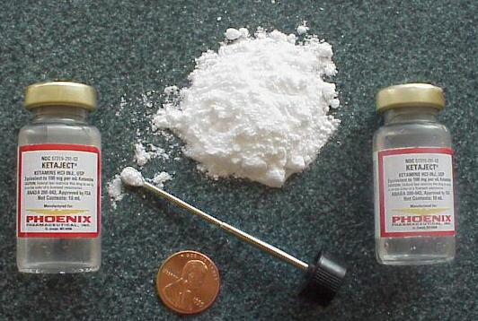
Seven Drug Categories
Dissociative Anesthetics

Slide 46

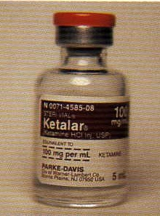
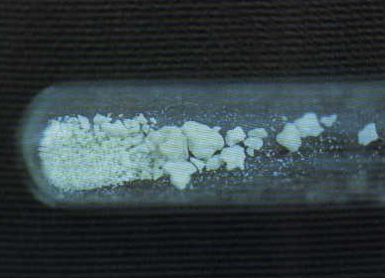
Dissociative Anesthetics
  PCP – Phencyclidine
  Analogs
  Ketamine
  Dextromethorphan

Slide 47
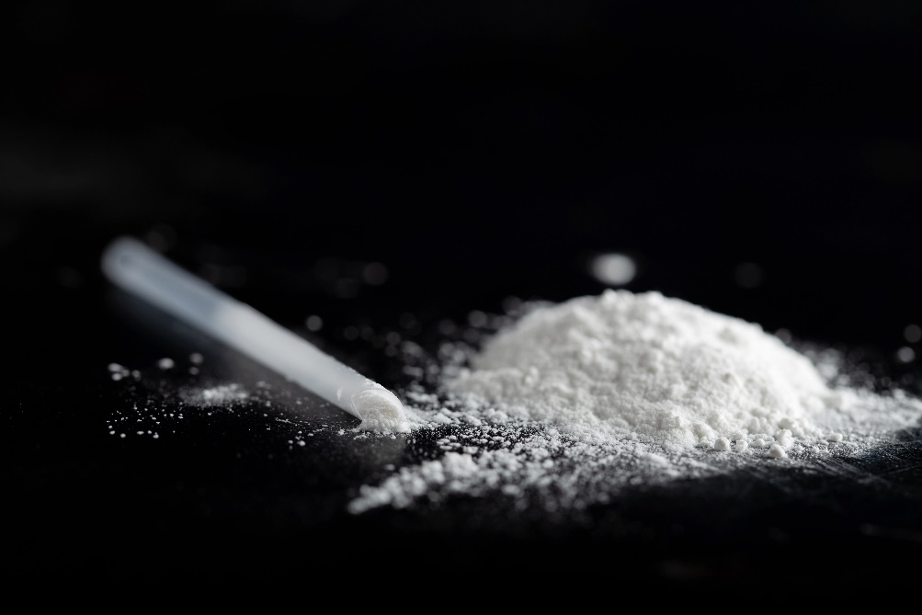
Methods of Administration
  Oral
  Insufflation
  Transdermal
  Eye Drops
  Smoked
  Injection

Slide 48
Effects of
Dissociative Anesthetic
  Cut off or distort the brain’s perception of the rest of the body’s senses (Dissociate)
  Increase user’s pain threshold (Anesthetic)

Slide 49
General Indicators
Blank stare
Cyclic behavior
Chemical odor
Hallucinations
Incomplete verbal responses
Perspiring
Slow, slurred speech

Slide 50
Eye Indicators
HGN | Present
VGN | Present
LOC | Present
Pupil Size | Normal

Slide 51
Duration of Effects
Type | Duration
DXM | 3 – 6 hours
Ketamine | 30 – 45 minutes (injected) 45 – 60 minutes (insufflation) 1 – 2 hours (orally)
PCP | 4 – 6 hours

Slide 52
Overdose Signs and Symptoms
  Coma
  Respiratory depression
  Seizures and convulsions

Slide 53

Conditions That May Mimic
Drug Impairment
  Mental illnesses

Slide 54
Drug Matrix
 | CNS Dep. | CNS Stim. | Hall. | D.A. | N.A. | Inhalant | Cannabis
HGN | Present | None | None | Present
VGN | Present | None | None | Present
LOC | Present | None | None | Present
Pupil Size | Normal * | Dilated | Dilated | Normal
* Soma, Quaaludes, and some Antidepressants usually dilate pupils

Slide 55
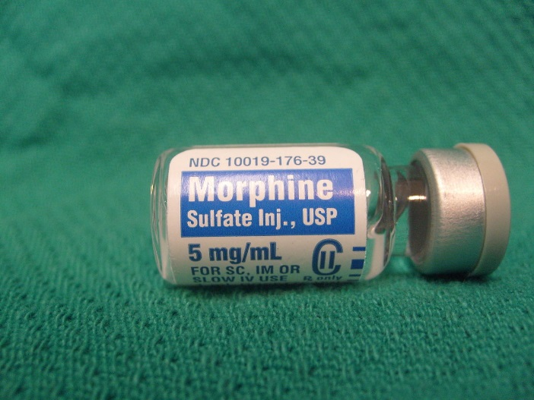
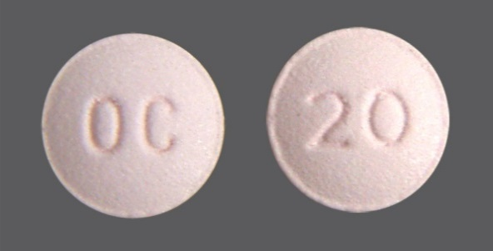
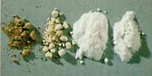
Seven Drug Categories
Narcotic Analgesics

Slide 56
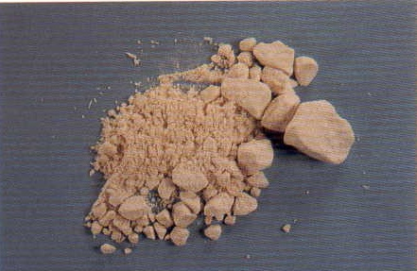
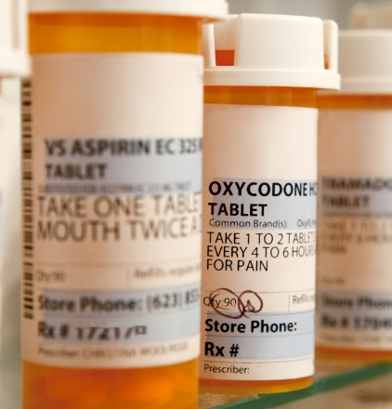
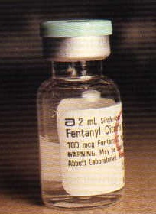

Identification of
Narcotic Analgesics
Notes:
Identification of Narcotic Analgesics
The most familiar Narcotic Analgesic is heroin.
Other Narcotic Analgesics include:
Hydrocodone (Norco, Vicodin, Lortab)
Tylenol 3 (with codeine)
Buprenorphine (Subutex)
Morphine (MS Contin)
Oxycodone (Oxycontin)
Fentanyl (Actiq, Sublimaze)
Typically, these are prescription drugs and found in pill form. The shape, size, or scoring can depend on the manufacturer or milligram amount. In most cases, Narcotic Analgesics are obtained in local pharmacies and sold locally. These drugs are inexpensive and frequently prescribed, but nevertheless remain a controlled substance.

Slide 57





Heroin

Slide 58


Methods of Administration

Slide 59
Effects of Narcotic Analgesics
  Usually very addictive
  Addicts who stop using may suffer physical withdrawal symptoms
  Users may develop a tolerance to the drug

Slide 60
General Indicators
Depressed reflexes
Droopy eyelids
Drowsiness
Dry mouth
Euphoria
Itching
Nausea
“On the nod”
Puncture marks
Slow breathing
Slow, low, raspy speech
Notes:
General Indicators
Droopy eyelids
“On the nod” (Semiconscious type state of deep relaxation)
Explain “on the nod” and how it differs from someone “crashing” after high doses of CNS Stimulants.
Drowsiness
Depressed reflexes
Dry mouth
Slow, low, raspy speech
Euphoria
Puncture marks
Itching (Face, arms or body)
Nausea
Slowed breathing

Slide 61
Eye Indicators
HGN | None
VGN | None
LOC | None
Pupil Size | Constricted

Slide 62
Duration of Effects
Type | Duration
Fentanyl | 2 – 3 hours
Heroin | 3 – 5 hours
Hydrocodone | 4 – 8 hours
Methadone | 6 – 8 hours
Oxycodone | 3 – 6 hours
Vicodin | 4 – 8 hours

Slide 63

Overdose Signs
Clammy skin
Coma
Convulsions
Slow and shallow breathing

Slide 64
Conditions That May Mimic
Drug Impairment
Fatigue
Head injuries
Diabetic reactions
Hypotension (low blood pressure)
Severe depression

Slide 65
Drug Matrix
 | CNS Dep. | CNS Stim. | Hall. | D.A. | N.A. | Inhalant | Cannabis
HGN | Present | None | None | Present | None
VGN | Present | None | None | Present | None
LOC | Present | None | None | Present | None
Pupil Size | Normal * | Dilated | Dilated | Normal | Constricted
* Soma, Quaaludes, and some Antidepressants usually dilate pupils

Slide 66




Seven Drug Categories
Inhalants

Slide 67








Identification of Inhalants

Slide 68


Methods of Administration

Slide 69
Effects of Inhalants
  Vary widely depending on the substance inhaled
  Typically, Inhalant abuser will generally appear to be intoxicated on alcohol

Slide 70
General Indicators
Bloodshot eyes
Confusion
Disoriented
Flushed face
Odor of substance
Possible nausea
Residue of substance
Slurred speech
Uncoordinated

Slide 71
Eye Indicators
HGN | Present
VGN | Present (high doses)
LOC | Present
Pupil Size | Normal (may be dilated)

Slide 72
Duration of Effects
Type | Duration
Aerosols | Very short duration
Amyl Nitrite | Up to 20 minutes
Nitrous Oxide | Less than 5 minutes
Volatile solvents | Several hours

Slide 73
Overdose Signs and Symptoms
  Cardiac arrhythmia
  Sudden sniffing death

Slide 74

Conditions That May
Mimic Drug Impairment
  Head injuries
  Inner ear disorders/Equilibrium

Slide 75
Drug Matrix
 | CNS Dep. | CNS Stim. | Hall. | D.A. | N.A. | Inhalant | Cannabis
HGN | Present | None | None | Present | None | Present
VGN | Present | None | None | Present | None | Present
LOC | Present | None | None | Present | None | Present
Pupil Size | Normal * | Dilated | Dilated | Normal | Constricted | Normal**
* Soma, Quaaludes, and some Antidepressants usually dilate pupils
** May be dilated

Slide 76




Seven Drug Categories
Cannabis

Slide 77




Forms of Cannabis
Marijuana Hashish
Hash Oil Edibles

Slide 78

THC Concentrations
1970’s
Current Levels
Wax
3% - 6%
30%+
80%-90%

Slide 79
Synthetic Cannabinoid Products
Olive colored herbs
Combination of herbs
Plant materials
Marinol

Slide 80



Methods of Administration
Smoked
Oral
Transdermal

Slide 81

Effects of Cannabis on Driving

Slide 82

General Indicators
Bloodshot eyes
Body tremors
Disoriented
Euphoria
Eyelid tremors
Impaired perception of time and distance
Odor of marijuana
Paranoia
Relaxed inhibitions
Sedation

Slide 83
Eye Indicators
HGN | None
VGN | None
LOC | Present
Pupil Size | Dilated (possibly normal)

Slide 84
Duration of Effects
Type | Duration
Marijuana (smoked) | 3-4 hours
Synthetics | 2-6 hours
Edibles | Up to 8 hours
Concentrates | Varies

Slide 85

Overdose Signs and Symptoms
Excessive Vomiting
Possible Psychosis

Slide 86
Conditions That May Mimic
Drug Impairment
Mental illnesses

Slide 87
Drug Matrix
 | CNS Dep. | CNS Stim. | Hall. | D.A. | N.A. | Inhalant | Cannabis
HGN | Present | None | None | Present | None | Present | None
VGN | Present | None | None | Present | None | Present | None
LOC | Present | None | None | Present | None | Present | Present
Pupil Size | Normal * | Dilated | Dilated | Normal | Constricted | Normal** | Dilated***
* Soma, Quaaludes, and some Antidepressants usually dilate pupils
** May be dilated
*** May be normal

Slide 88

Officer Safety
Notes:
B. Officer Safety

Slide 89
Questions?

